Slide 1
Design a Support Chatbot App for a Family Restaurant in California Usability study
December 2021
Team
UXR Roman

Slide 2
Table of Contents
Section 1 Study Details
Section 2 Themes
Section 3 Insights & Recommendations

Slide 3
Study Details

Slide 4
Project Background
I'm design a support chatbot app for a family restaurant in California to attract and retain customers in our future online system. I noticed that our competitor offer dedicate mobile apps for their customers to order through, but they don't take into account many points due to which customers don't get satisfaction and the proper result from the process, so competitors cannot be as successful as they could be. I want to design a product that can increase customer satisfaction and thanks to this, increase sales in comparison with competitors.

Slide 5
Study Details
Research Questions
Participants
Methodology
How long does it take for a user to make an order in the app?
Are users able to successfully make an order? What can I learn from the steps took to make an order? Are there any parts of the ordering process where users are getting stuck?
Is the payment process easy for the users?
5 participants
2 males, 3 females between the ages of18-75
10 minutes per participant
United States, remote
Unmoderated usability study
Users were asked to perform tasks in low-fidelity prototype

Slide 6
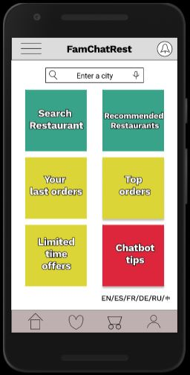
Prototype / Design Tested
Link to the prototype
https://www.figma.com/proto/VIejjD25W3ZLSOVjp2p2Bf/Digital_wireframes?node-id=1%3A2&scaling=scale-down&page-id=0%3A1&starting-point-node-id=1%3A2

Slide 7
Themes

Slide 8
For many participants starting an order selection process is difficult
2 of the 5 participants didn’t know where to start an order selection process.
Not all participants who wanted to make an order expressed the same level of frustration.
“I get no idea where to start.” (Participant A)
“I don’t know where to start.” (Participant B)
a

Slide 9
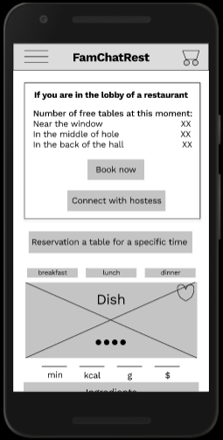
For many participants the ability to group orders and split invoices is useful
2 of the 5 participants were looking for non-existent features for group order and split invoice.
Not all participants who made the order successfully spoke out for the need to be able to place group orders and split invoices.
“Where is the group table reservation.” (Participant A)
“I would like to see detailed division of the account.” (Participant C)
a

Slide 10
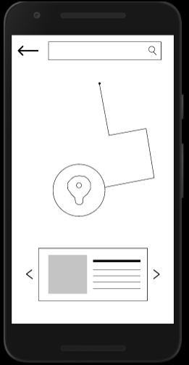
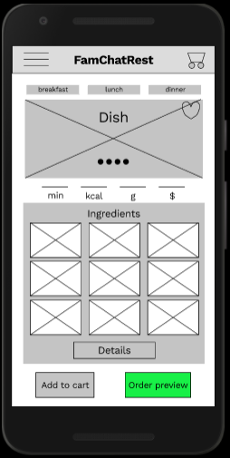
For many participants scrolling through the singly presented restaurants and menu items is inconvenient and unusual
2 of the 5 participants have difficulty scrolling through the singly presented available restaurants and menu items.
Not all participants who wanted to make an order expressed the same level of frustration.
“On the search page, I’m personally more comfortable and more accustomed to when I need to leaf through restaurants in a list, and not one at a time. The same goes for the choice of dishes.” (Participant C)
“Why only one restaurant is displayed on the search page.” (Participant D)
b
a

Slide 11
Insights & Recommendations

Slide 12
Research insights
Starting an order selection process if difficult
Scrolling through the singly presented restaurants and menu is inconvenient
Unable to group orders and split invoices
Users need tips on where to start the ordering process
Users need features to group orders and split invoices
Users need a list view of the abailable restaurants and menu items

Slide 13
Recommendations
When downloading the app, it’s need to add an introductory screen that briefly visually explains the steps to start the ordering process. Also add the option not to display this screen for the already knowledgeable power users of the application.
Add features for group orders and split invoices.
Redesign the single view of available restaurants and menu items to list views.

Slide 14
Thank you!

